Slide 1

CAR POLLS AND PREDICTIONS
N .SRI HARI (18BCA0027)
VANDEMATARAM J (18BCA0033)
T . FASIULLAH (18BCA0042)

Slide 2

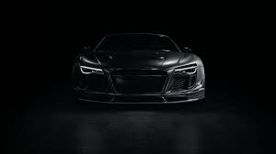
ABSTRACT
CAR POLLS is helpful to calculate and predict the best between competitors . Here we conduct the POLLS across the automobile companies . Cast your vote in our CAR POLLS ! To help the ensure accuracy ,visitors are limited to one vote per online poll questions .
The descriptioin about the cars and the specifications are available . The new car users can use this CAR POLL for better ideology in buying their cars .
The prediction is usefull for the companies to develop the upcomming models . We conduct this polls according to the models released by the respective company in last few years.
This will useful for the ordinary man helps to find qualities of cars or other automobile .

Slide 3

Sign up or Log in
If the user have a username or an account.He/she can continue with that otherwise user should create a account by clicking sigh up to continue.If they have they can continue with username and password.
If user did,t have account they can create account by sign up option.on the sign up user should include they information including username and password.By next time user continue with they account.

Slide 4

New car price& Notification
In the new car price, market car prices and other prices details will be displayed.by which your can get information or update about the car prices for the certain car models.
Notification helps the user to get the notification about car’s prices,new car models released or will release at time.This will help user to get information faster.

Slide 5


Popular Brands& Vehicles
Here user can get some information or vehicles about popular brands and vehicles that means details about the company or information of the vehicle i.e features,prices etc..

Slide 6
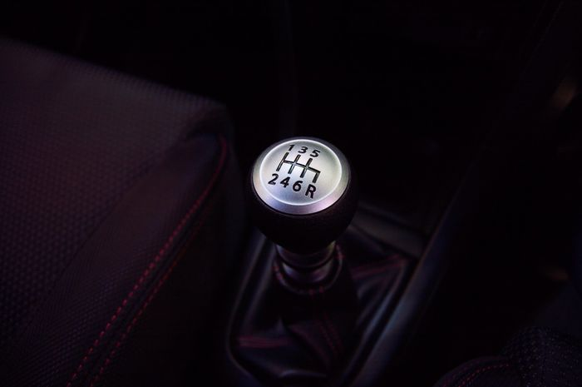
Car ranking
Here cars are ranked according from their performance and their features and prices etc.. And also by customers reviews.
This car ranking helps user to find the quality cars according to their budgets.this ranking is according to done by the cars released by car companies.

Slide 7
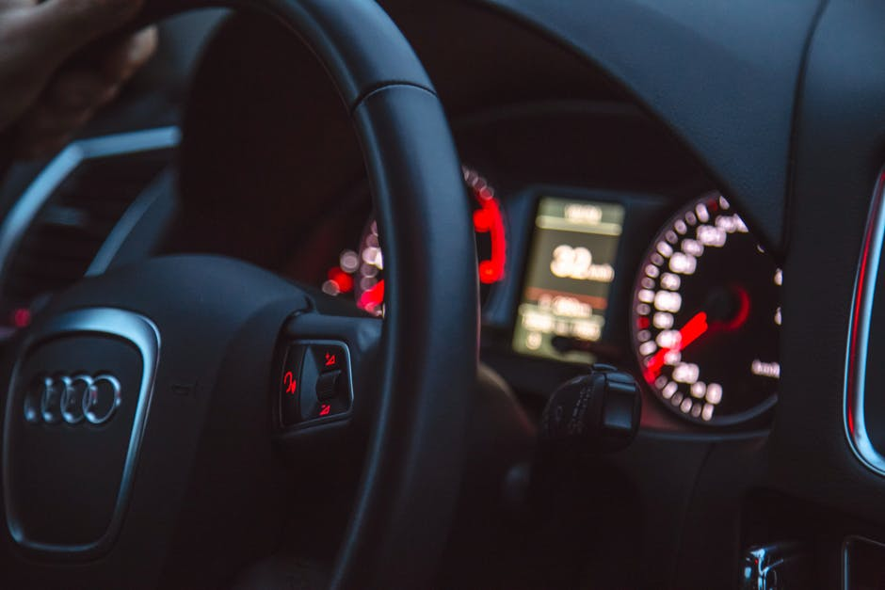
Car reviews
Here user can write their own experience about the car.They bought or used for years.
This will help other your to pick the other brand’s cars they required.This contains quality, comfortable, safety or an security of their cars.
This will also consider for an car ranking.

Slide 8

Contact us
Here user of our website can contact with us direct way by facebook, whatsapp ,instagram etc..
User can give review or ask some change for our website.
This will help us to solve our problems or queries in our websites to look good one.

Slide 9

Car voting poll
This is voting poll are the main part of our webpage.
Voting poll will conduct among popular branches by their cars released in last few years.
In this voting poll user only can participated to vote their branches by their wish.
This voting poll can be linked with database and result of this voting will be published afterward in our webpage.

Slide 10

THANK YOU

